Slide 1

Project Name: Electric Car Powertrain Sizing
Submitted By: Patel Nishantkumar Vasantbhai
Course Name: Electric Vehicle Powertrain Sizing Nano Degree Program
Guide: Santosh Kumar
Institute: Elite Techno Groups
Education: B.E. Mechanical (bachelor of engineering)
Certificate No.:
ETG-EV-1116 (for verification or authorization checking)
Date of Submission: 20/11/2021

Slide 2
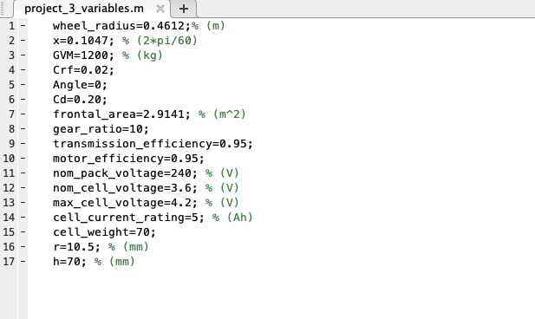
Problem Statement:
Questions:
Question-1:
Model Screenshot (system & sub-system level)
Question-2:
Plots for different parameters with description (FTP Highway)
Question-3:
Battery Block additional sub questions ( Range= 250 Km)
Total no. of cells
Cell volume
Battery pack volume
Maximum voltage of pack
Weight of battery pack
Given Parameters:

Slide 3
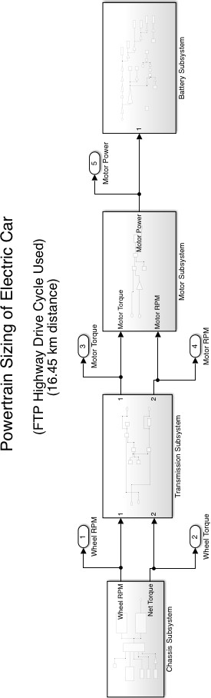
Question-1: Simulink Model Photos
Here, we considered the FTP Highway drive cycle and modelled the whole system based on it.

Slide 4
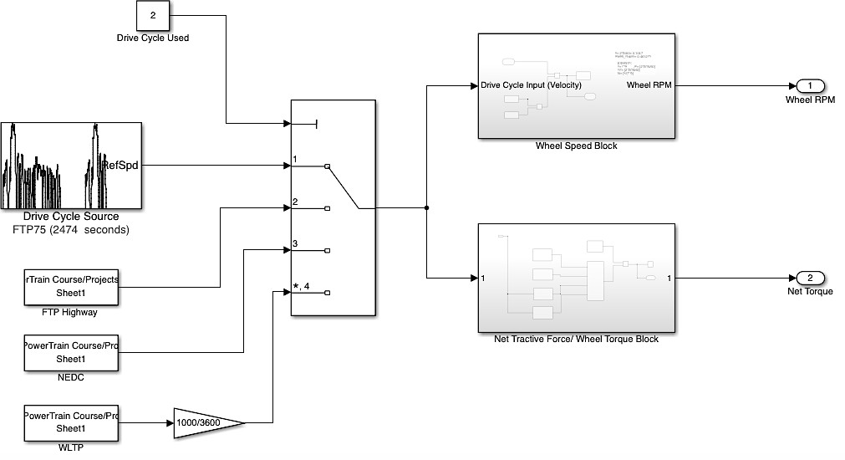
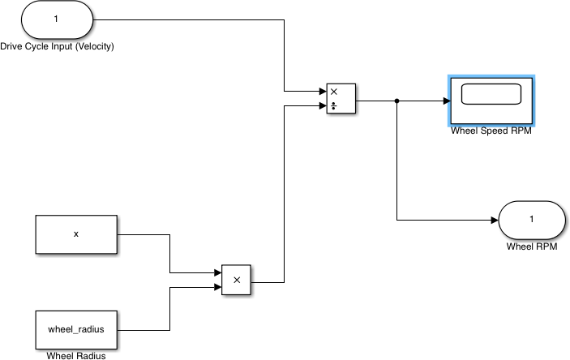
a.) Chassis Subsystem:
a.1) Wheel Speed Block:

Slide 5
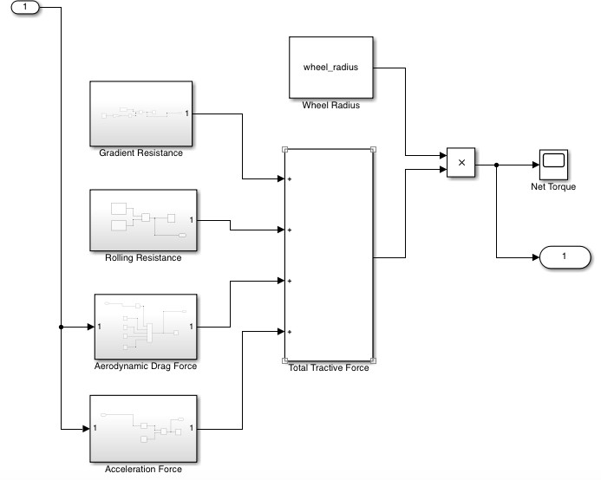
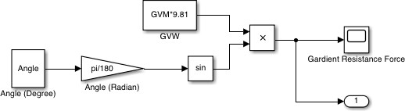
a.2) Net Torque Block:
a.3) Gradient Resistance:

Slide 6
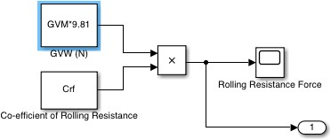
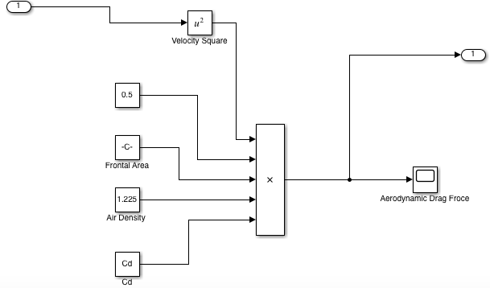
a.4) Rolling Resistance:
a.5) Aerodynamic Drag:

Slide 7
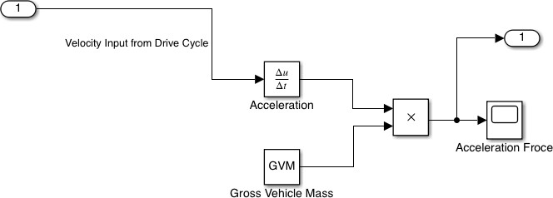
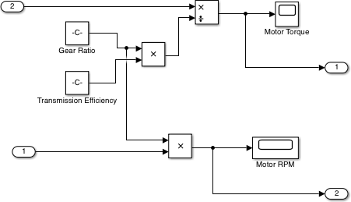
a.6) Acceleration Force:
b.) Transmission Subsystem:

Slide 8
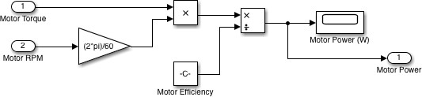
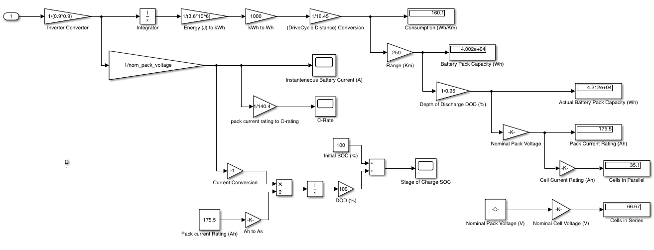
c.) Motor Subsystem:
d.) Battery Subsystem:

Slide 9
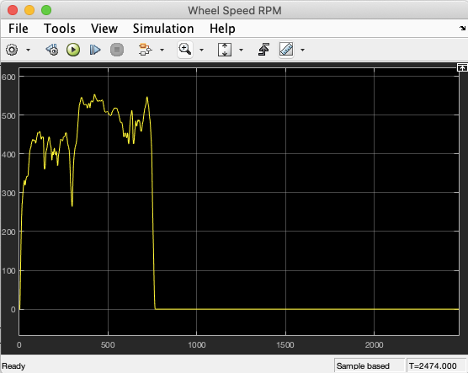
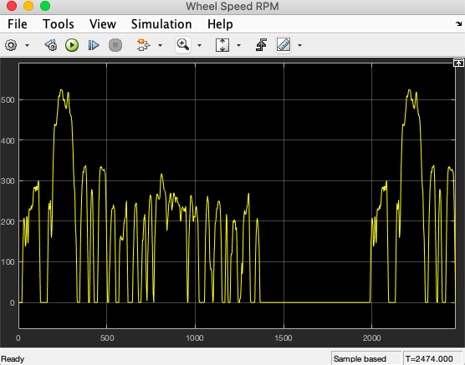
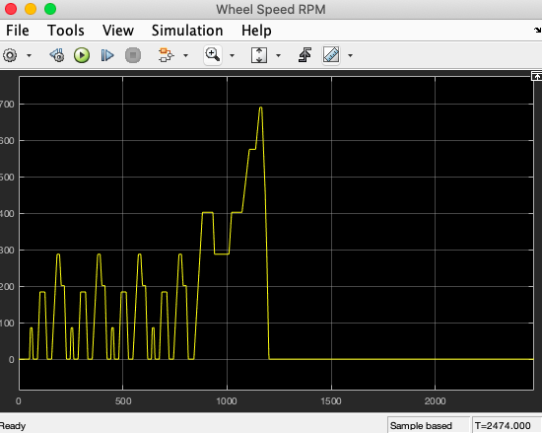
Question-2: Plots with Description:
2.1) Wheel Speed(RPM):
Wheel Speed (RPM) graph indicates the maximum speed at around 550 rpm. Most of the time it is in the range of 400 to 500 rpm.
FTP 75 Drive Cycle NEDC Drive Cycle

Slide 10
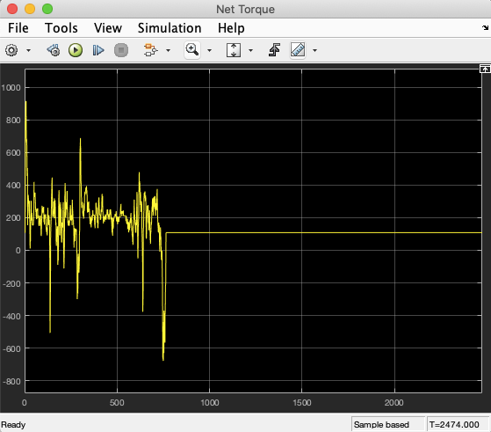
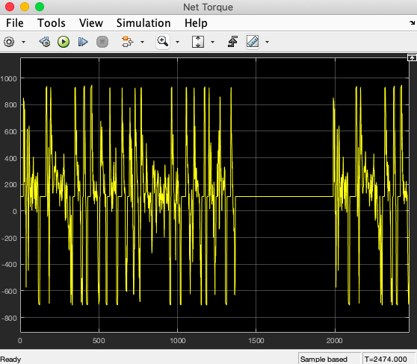
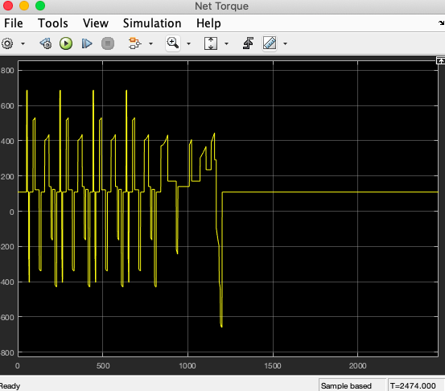
2.2) Net Torque (Nm):
Net Torque graph has maximum value of around 900 Nm, and this graph indicates that most of the time it is in the range of 200 to 400 Nm. Few times it goes below zero with maximum negative value of around 700 Nm.
FTP 75 Drive Cycle NEDC Drive Cycle

Slide 11
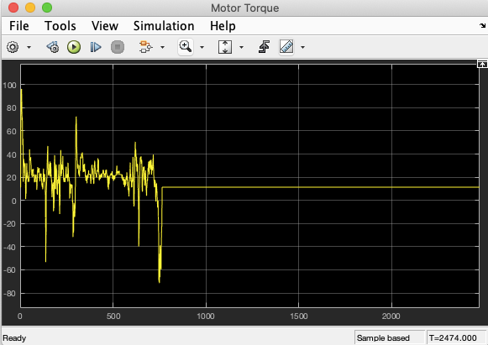
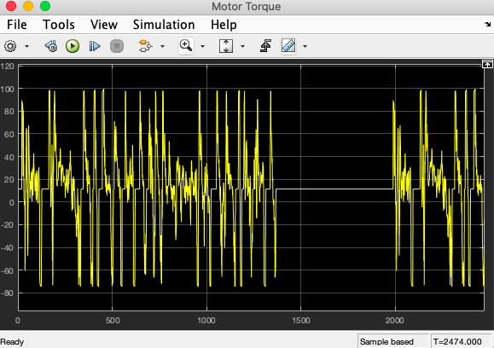
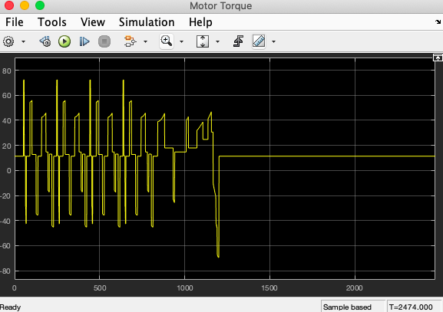
2.3) Motor Torque (Nm):
Motor Torque graph has maximum value of around 100 Nm, and this graph indicates that most of the time it is in the range of 0 to 40 Nm. Few times it goes below zero with maximum negative value of around 65 Nm. At the initial stage it touches maximum torque.
FTP 75 Drive Cycle NEDC Drive Cycle

Slide 12
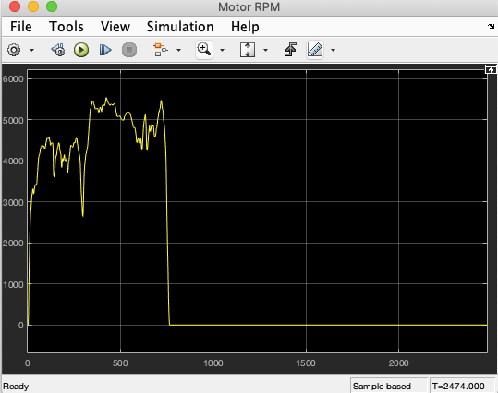
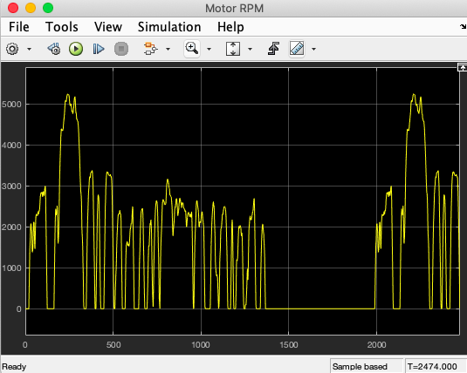
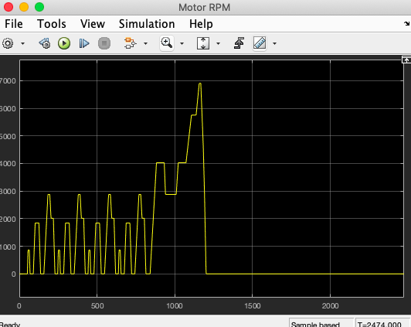
2.4) Motor Speed (RPM):
Motor RPM graph has maximum value of around 5500 rpm, and this graph indicates that most of the time it lies in the range of 3000 to 5000 rpm. RPM never going to be zero or negative value.
FTP 75 Drive Cycle NEDC Drive Cycle

Slide 13
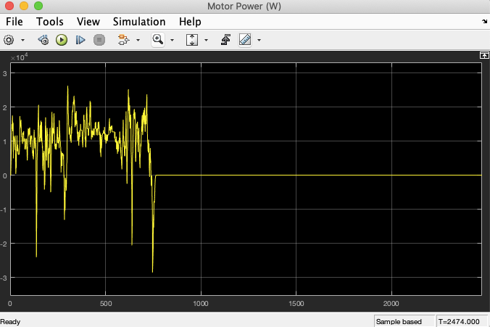
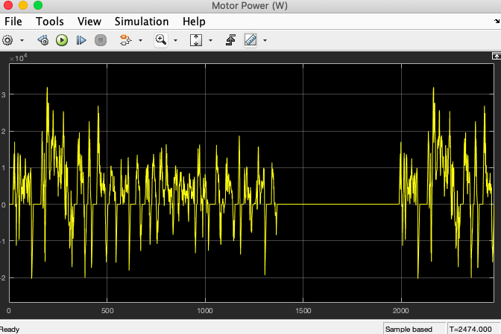
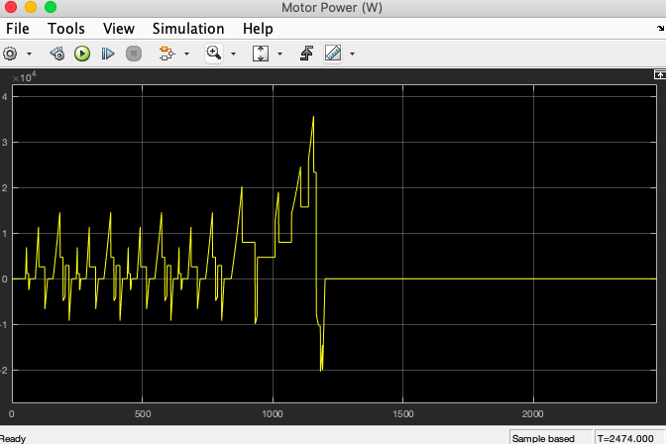
2.5) Motor Power (Watt):
Motor Power chart has maximum value of around 25 kW, and this graph indicates that most of the time it is in the range of 0 to 20 kW. Few times it goes below zero with maximum negative value of around 30 kW.
FTP 75 Drive Cycle NEDC Drive Cycle

Slide 14
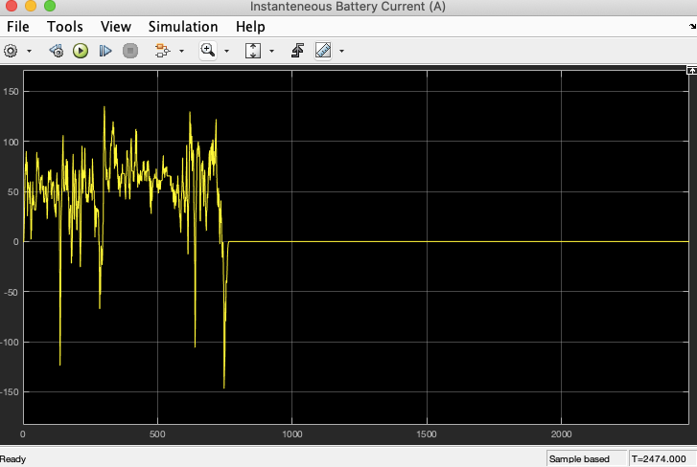
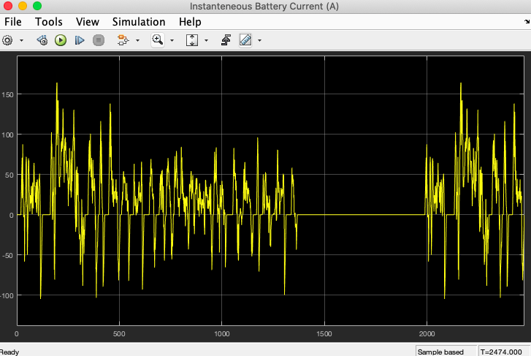
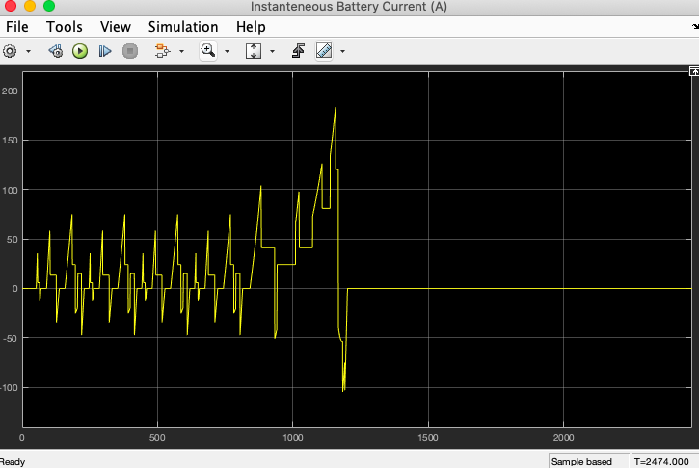
2.6) Instantaneous Battery (A):
Instantaneous Current chart has maximum positive value is of around 175 A, and negative value at about -150 A. Most of the time it lies between 0 and 100 A.
FTP 75 Drive Cycle NEDC Drive Cycle

Slide 15
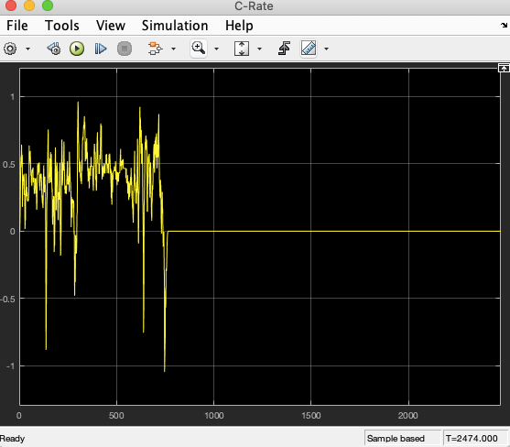
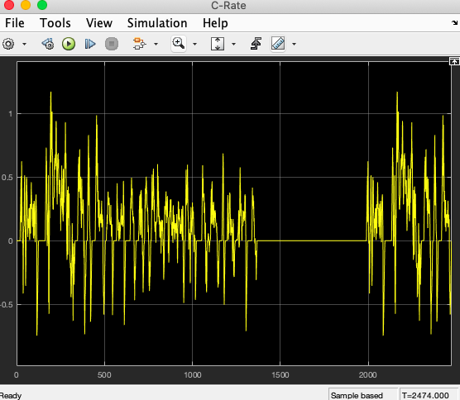
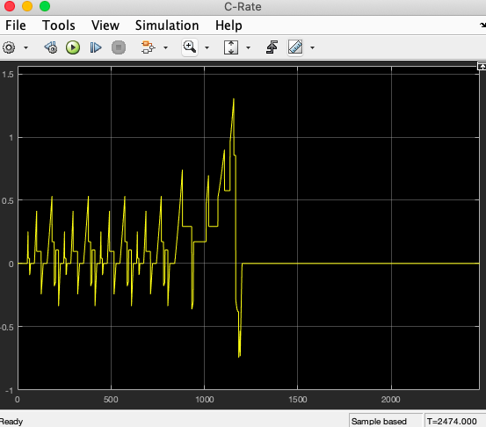
2.7) C-Rate:
C-Rate graph indicates frequent variations over the time because of instantaneous current. C-rate value mostly stay between in the range of 0 to 0.5 C.
FTP 75 Drive Cycle NEDC Drive Cycle

Slide 16
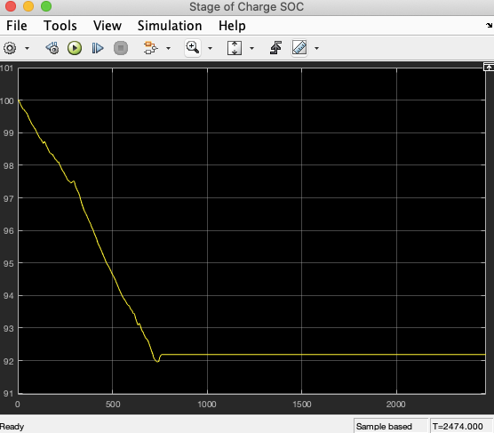
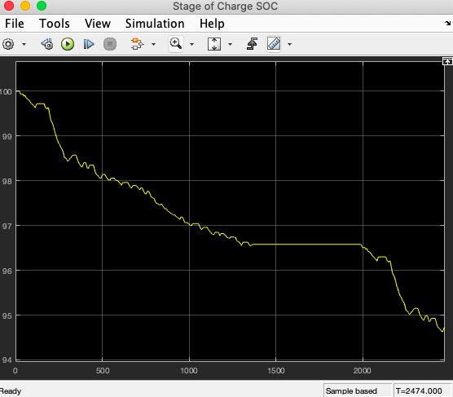
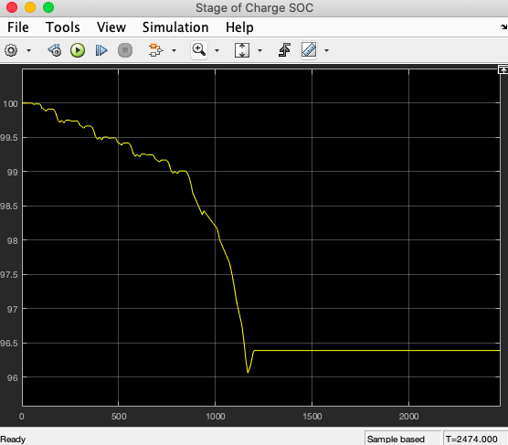
2.8) State of Charge SOC (%):
SOC chart represents the SOC percentage of battery pack. Firstly Initial SOC is 100% then gradually with the time it has fallen down to 92%.
FTP 75 Drive Cycle NEDC Drive Cycle

Slide 17
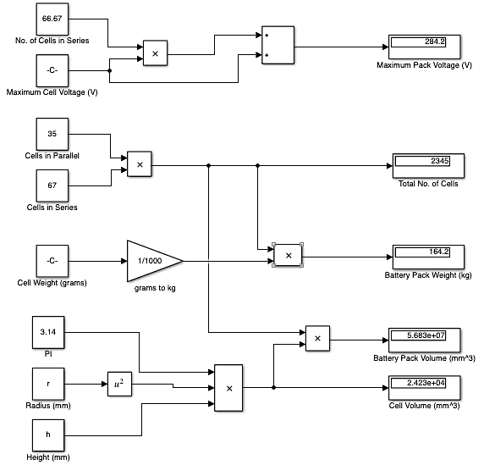
Question-3: Battery Pack Questions:
Total No. of Cells = 2345
Cell Volume = 2.423*10⁴ mm³
Battery Pack Volume = 5.68*10⁷ mm³
Maximum Voltage of Pack = 284.2 V
Weight of Battery Pack = 164.2 kg

